Slide 1


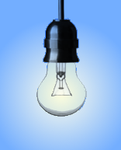


Lux IoT System
IoT Platform
External light contribution
Internal light balance
Light sensor

Slide 2
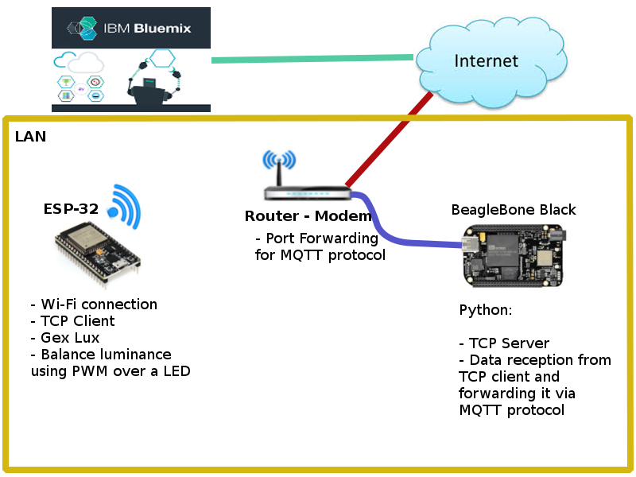
Lux IoT System - Diagram

Slide 3
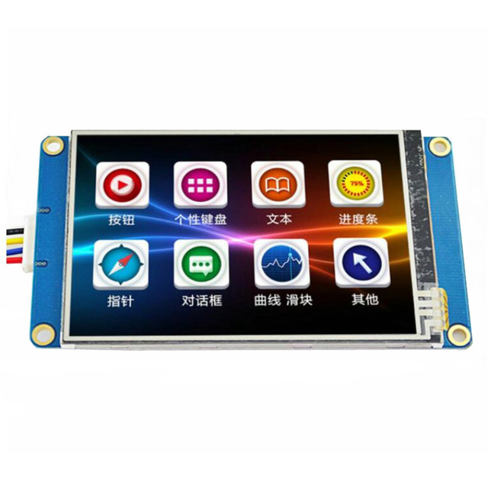
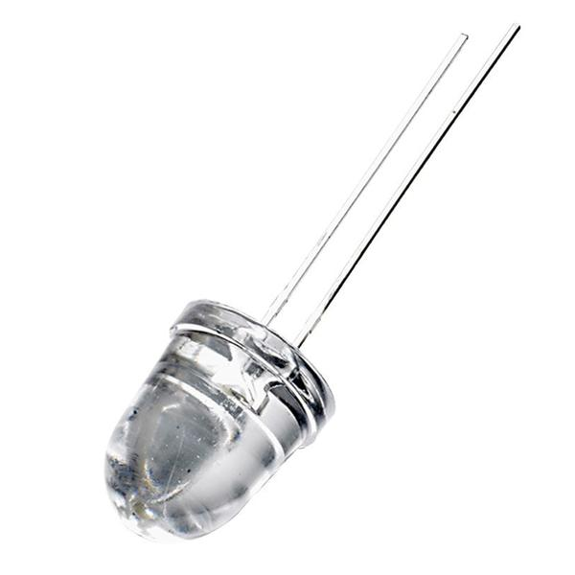

External light contribution
LED controlled using PWM
PIC16F886
Nextion TFT
Serial Touch Display

Slide 4
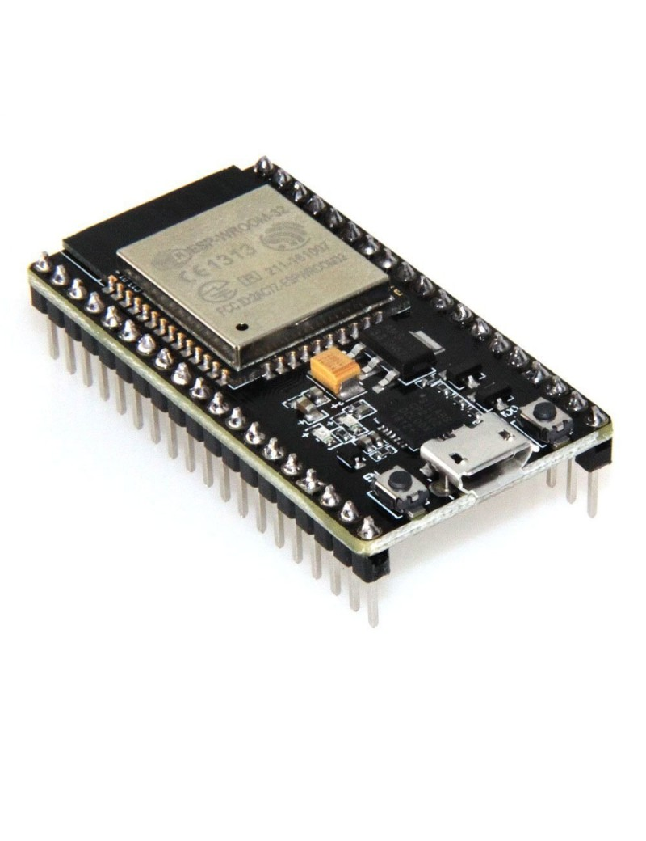
Test Environment - Lux IoT System
Isolated Box
External light
Contribution LED
Light sensor
MAX44009
Internal light
Balance LED
ESP-32
PIC16F886

Slide 5
Luminance limits and PWM values selected
ESP32 [NPN as switch : PWM Freq 1KHz , Resolution 16 bits -> factor 655 = 1%]
PWM Duty cycle % | Lux
37 | 146,88
43 | 171,36
51 | 195,84
57 | 220,32
63 | 244,8
69 | 269,28
75 | 293,76
81 | 318,24
87 | 342,72
Regular increment of 24.84 [lux] value.
Table 1: Result of empirical measures.

Slide 6
Luminance limits and PWM values selected
PIC16f886 [NPN as switch: PWM Freq 1KHz , Resolution 8 bits -> factor 51 = 10%]
PWM Duty cycle % | Lux
0 | 0
10 | 39,78
20 | 79,56
30 | 122,4
40 | 159,12
50 | 195,84
60 | 244,8
70 | 269,28
80 | 318,24
90 | 367,2
100 | 391,68
Irregular increments of [lux] values.
Table 2: Result of empirical measures.

Slide 7
Luminance limits and PWM values selected
Duty cycle array construction
Duty Cycle Array
Array position | Value
0 | 37 x factor
1 | 43 x factor
2 | 52 x factor
3 | 57 x factor
4 | 63 x factor
5 | 69 x factor
6 | 75 x factor
7 | 81 x factor
8 | 87 x factor
Table 3: Duty cycle array, position and values.

Slide 8
Luminance limits and PWM values selected
 | PIC16f886 | ESP32
Minimum Lux Val | 0 | 146,88
Maximum Lux Val | 391,68 | 342,72
Table 4: Result of empirical measures.
Luxiot system
lux_low_limit | 400
lux_high_limit | 500
The limits were selected arbitrarily to provoke controlled failures.
Table 5: Luminance limits.

